Slide 1

Branch - CSE Python Programming
Lecture – 18 Dictionary – Part 1
By
Dr. Smita Tiwari
Assistant Professor
Department of Computer Science and Engineering
School of Engineering & Technology

Slide 2
Python Dictionary
Unordered collection of items.
Each item has a key / value pair.
Dictionaries are optimized to retrieve values when the key is known.

Slide 3
Create Python Dictionary
Creating a dictionary is as simple as placing items inside curly braces {} separated by commas.
An item has a key and a corresponding value that is expressed as a pair (key: value).
While the values can be of any data type and can repeat, keys must be of immutable type (string, number or tuple with immutable elements) and must be unique.

Slide 4
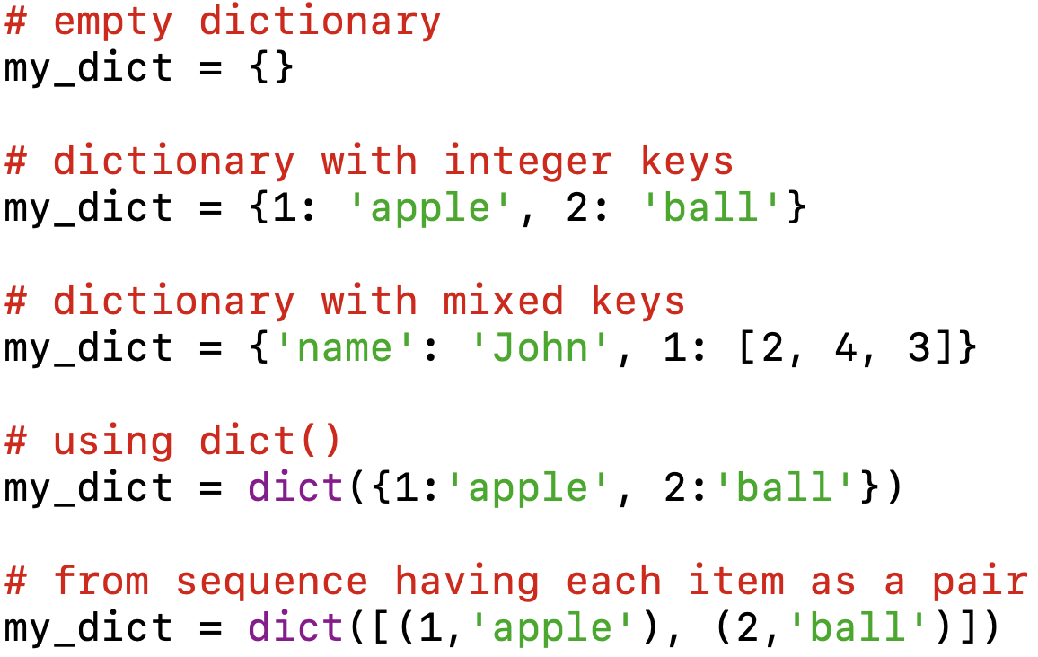
Create Python Dictionary

Slide 5
Accessing Elements from Dictionary
While indexing is used with other data types to access values, a dictionary uses keys.
Keys can be used either inside square brackets [ ] or with the get() method.
If we use the square brackets [], KeyError is raised in case a key is not found in the dictionary. Whereas the get() method returns None if the key is not found.

Slide 6
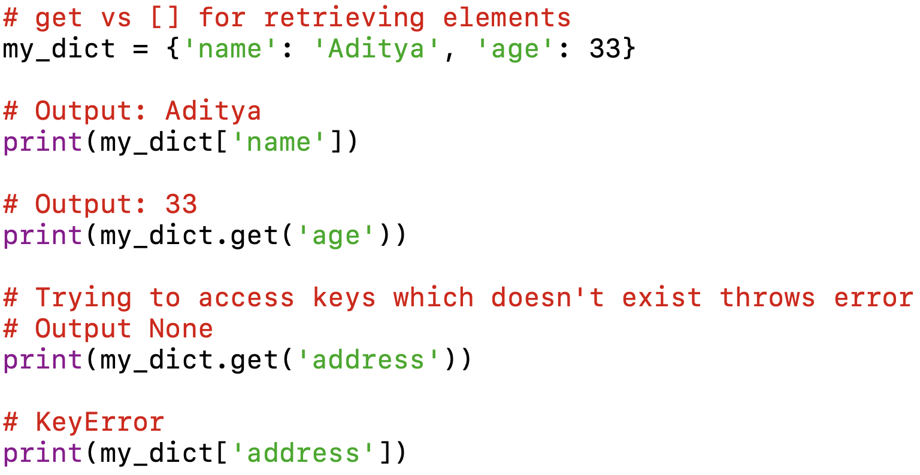
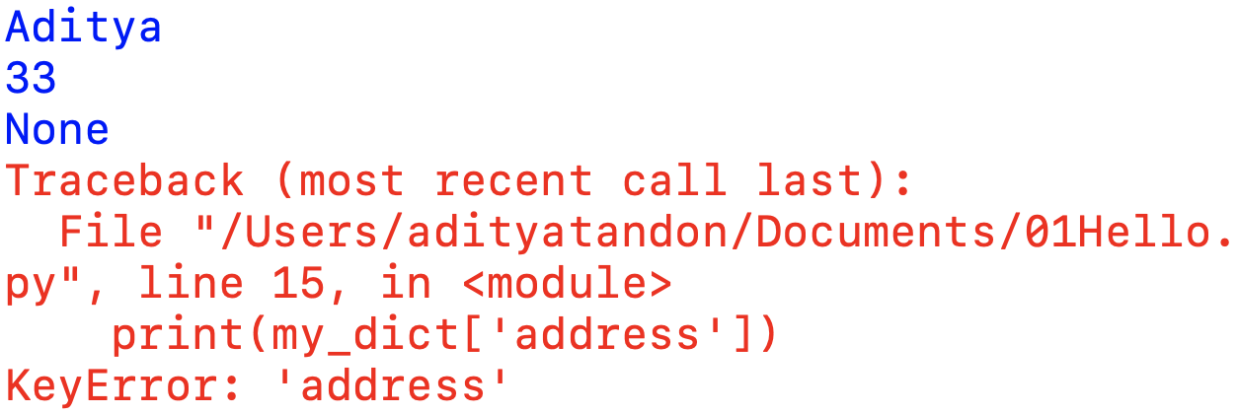
Accessing Elements from Dictionary
Output:

Slide 7
Changing and Adding Dictionary elements
Dictionaries are mutable.
We can add new items or change the value of existing items using an assignment operator.
If the key is already present, then the existing value gets updated.
In case, the key is not present, a new (key:value) pair is added to the dictionary.

Slide 8
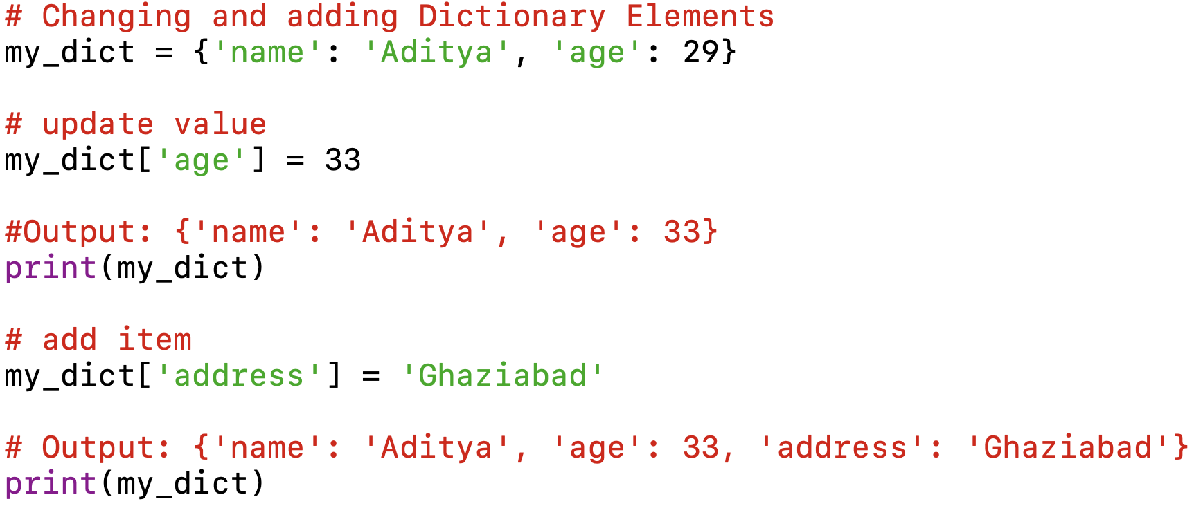
Changing and Adding Dictionary elements
Output:

Slide 9
Removing elements from Dictionary
We can remove a particular item in a dictionary by using the pop() method.
This method removes an item with the provided key and returns the value.
The popitem() method can be used to remove and return an arbitrary (key, value) item pair from the dictionary.
All the items can be removed at once, using the clear() method.
We can also use the del keyword to remove individual items or the entire dictionary itself.

Slide 10
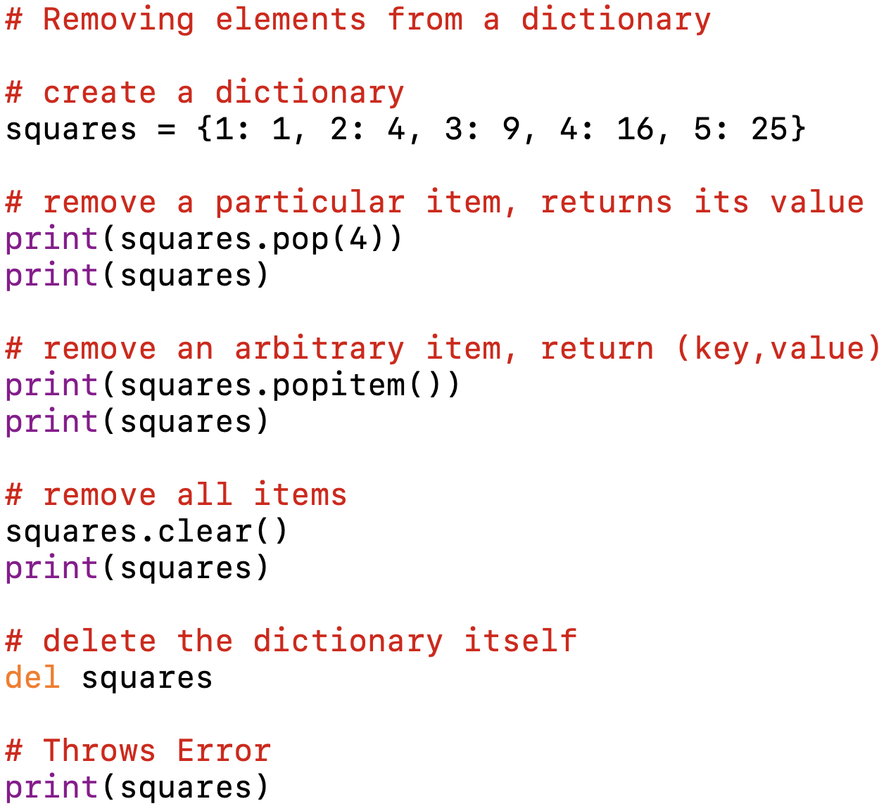
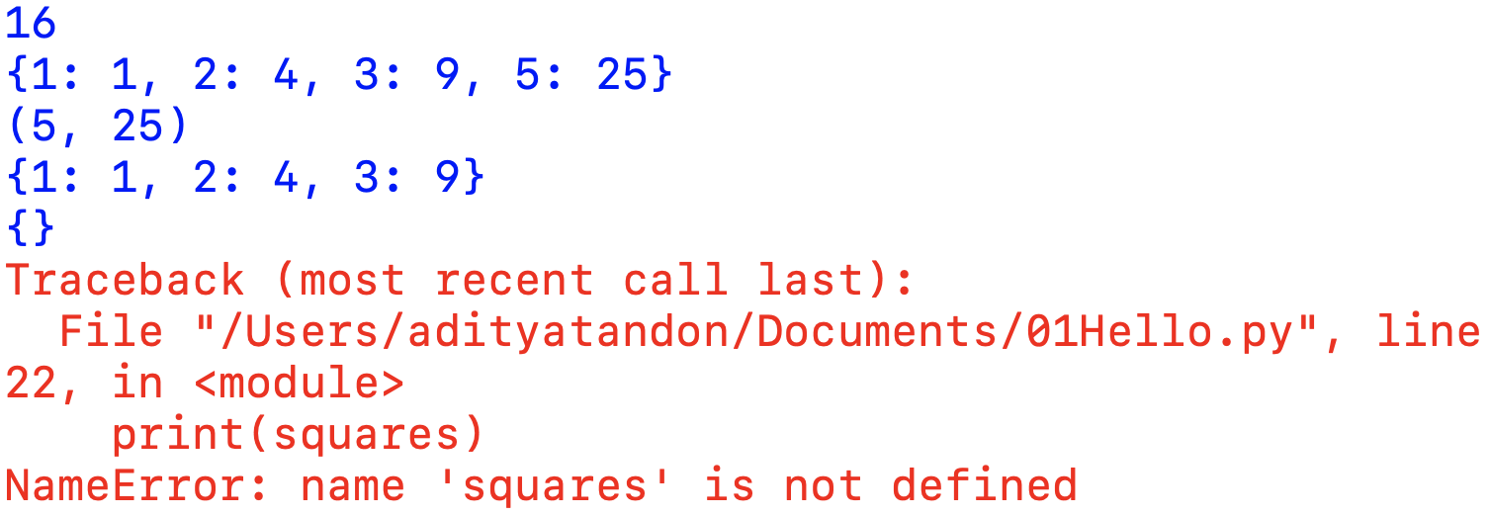
Removing elements from Dictionary
Output:

Slide 11
Python Dictionary Methods
Method | Description
clear() | Removes all items from the dictionary.
copy() | Returns a shallow copy of the dictionary.
fromkeys(seq[, v]) | Returns a new dictionary with keys from seq and value equal to v (defaults to None).
get(key[, d]) | Returns the value of the key. If the key does not exist, returns d (defaults to None).
items() | Returns a new object of the dictionary’s items in (key, value) format.
keys() | Returns a new object of the dictionary’s keys.
pop(key[, d]) | Removes the item with the key and returns its value or d, if key is not found. If d is not provided and the key is not found, it raises KeyError.

Slide 12
Python Dictionary Methods
Method | Description
popitem() | Removes and returns an arbitrary item (key, value). Raises KeyError if the dictionary is empty.
setdefault(key[, d]) | Returns the corresponding value if the key is in the dictionary. If not, inserts the key with a value of d and returns d (defaults to None).
update([other]) | Updates the dictionary with key/value pairs from other overwriting keys.
values() | Returns a new object of the dictionary’s values

Slide 13
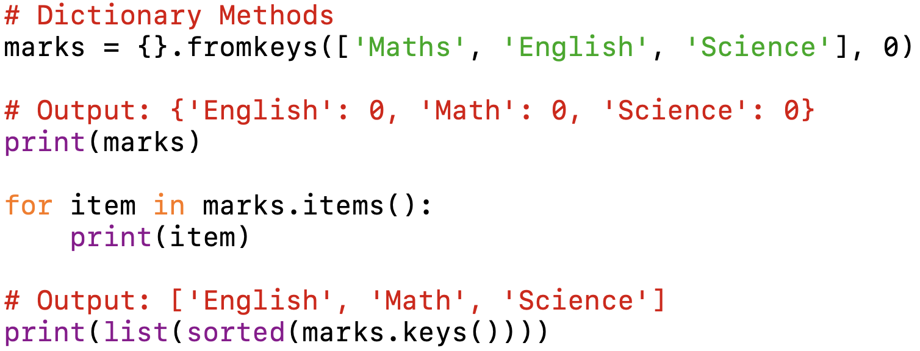
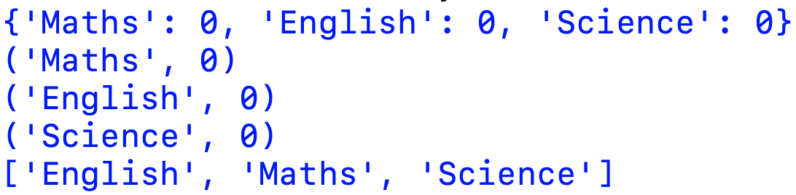
Python Dictionary Methods
Output:

Slide 14
THANK YOU

